Slide 1
PhysioNet Challenge – AF classification
Speaker: Yu-Cheng, Lin
Advisor:
Date: 2019/10/03

Slide 2
Outline
Paper survey(14,17,20)
Discussion
Reference

Slide 3
Paper 14

Slide 4
About this paper
Title: Can Supervised Learning Be Used to Classify Cardiac Rhythms?
Author: Marcus Vollmer, Philipp Sodmann, Leonard Caanitz, Neetika Nath, Lars Kaderali
Final accuracy: 0.81

Slide 5
Framework
Training CNN model for generating annotation sequence
Feature extraction
Random forest classifier

Slide 6
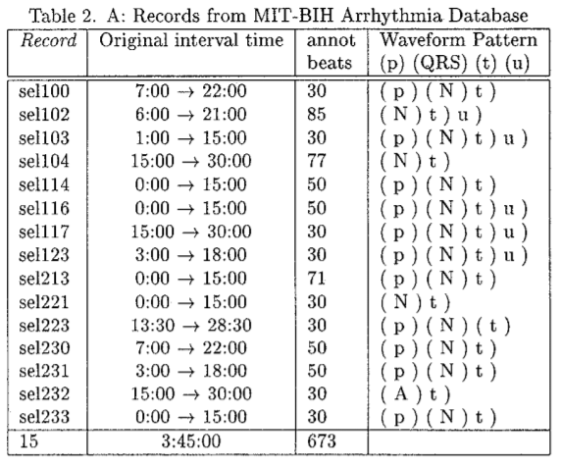
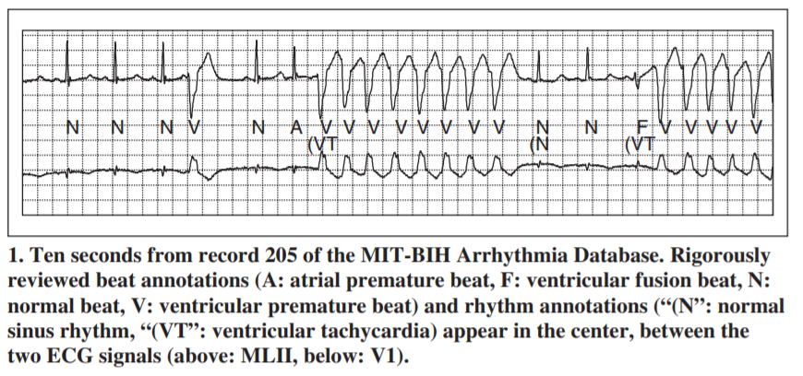
Annotation sequence
Mapping ECG signal to annotation sequence(R,P,T,~,O,unknown)
R, P, T from QT-database [1], O from MIT-BIT database [2]
~ by realistic noise generate by WFDB
$$X=\left[x_{1},x_{2},…,x_{n}\right]→a=\left[a_{1},a_{2},…,a_{n}\right]$$
Refer to [2]
Refer to [1]

Slide 7
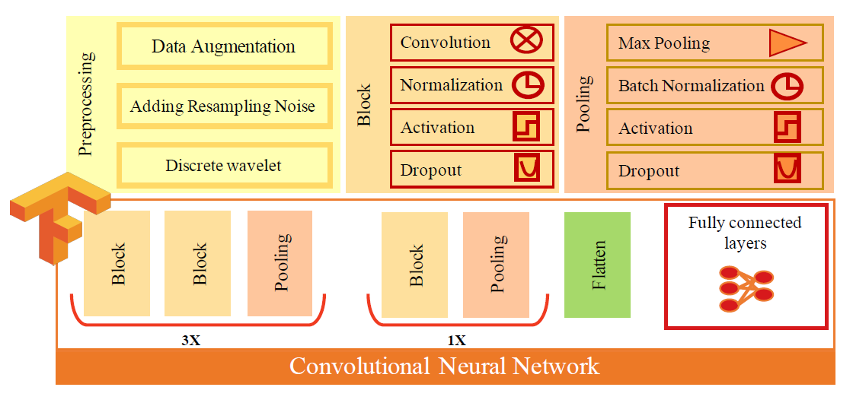

Training CNN model
Database: QT database & MIT-BIH arrhythmia database & generated noisy signal
Augmentation: $±$17ms window size, add white noise
Training data: Total 12,000,000 charateristic waveform
Result: 99.7% accuracy for 50ms tolerance

Slide 8
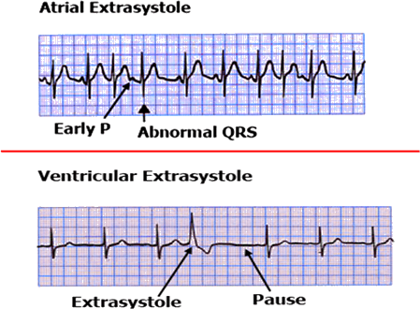
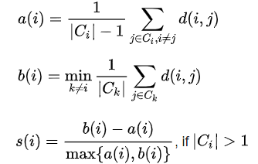
Feature extraction
Absolute value, interquatiles range for RR, RT, PR intervals
Percentage of extrasystoles(single, doublets, triplets)
Silhoutte score(compute correlation of each pair of heart beat +> kmeans on the basis of correlation metrics )

Slide 9
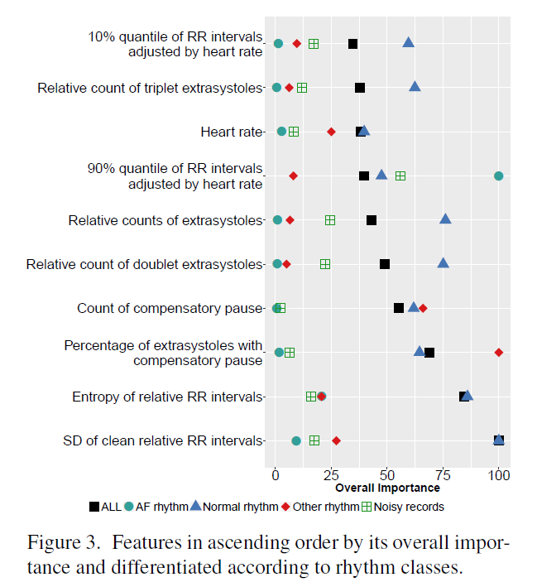
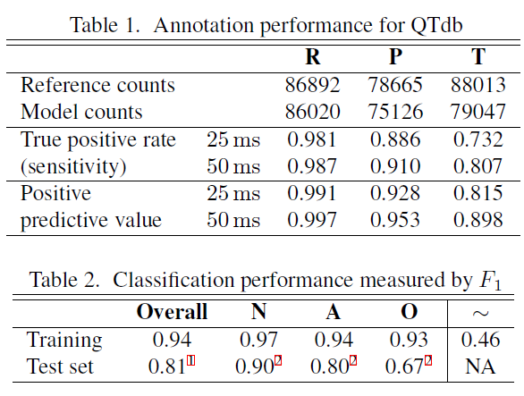
Training
Random forest classfier

Slide 10
Paper 17

Slide 11
About this paper
Title: Rhythm and Quality Classification from Short ECGs Recorded Using a Mobile Device
Author: Joachim A. Behar, Aviv A. Rosenberg, Yael Yaniv, Julien Oster
Final accuracy: 0.80

Slide 12
Framework
Preprocessing
Feature extraction
SVM classifier

Slide 13
Preprocessing
Use jqrs to detect R-peaks
Jqrs/epltd/ggrs detectors were used to estimate the quality of the signal by bsqi

Slide 14
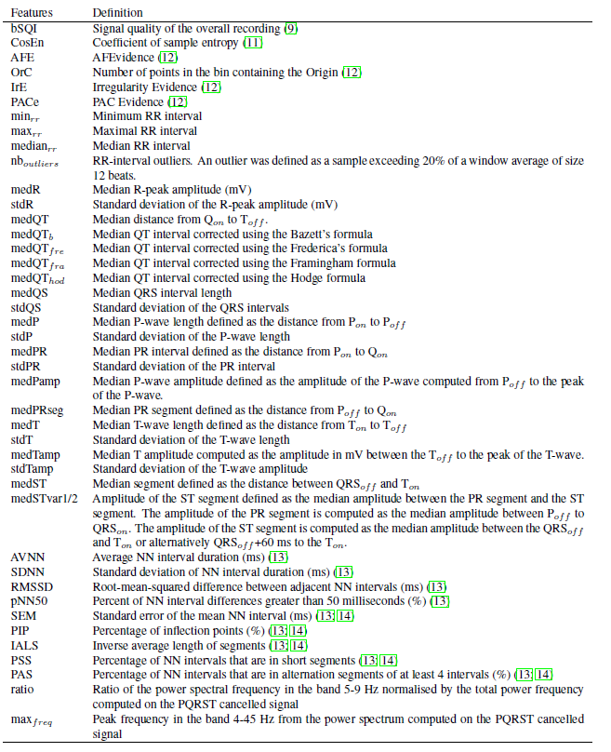
Feature extraction
Signal quality
Predictability of RR intervals
ECG morphology(QRS duration, QT interval, …)
Heart rate variability
Fragmentation measures

Slide 15
Training result
Cascaded classification due to unbalanced data
First: N/OA~
Second: A/O~
Third: ~/O

Slide 16
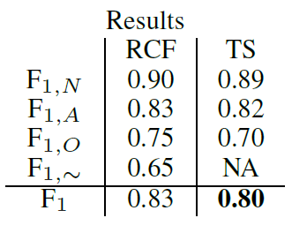
Training result
Top five features for distinguishing
N/OA~: min_{rr}, AVNN, PAS, medR, medST
A/O~: IrE, CosEn, AFE, F₁, median_{rr}
~/O: medTamp, PACe, stdP, F₁, stdR

Slide 17
Paper 20

Slide 18
About this paper
Title: Hierarchical Cardiac-Rhythm Classification Based on Electrocardiogram Morphology
Author: Dionisije Sopic, Elisabetta De Giovanni, Amir Aminifar, David Atienza
Final accuracy: 0.80

Slide 19
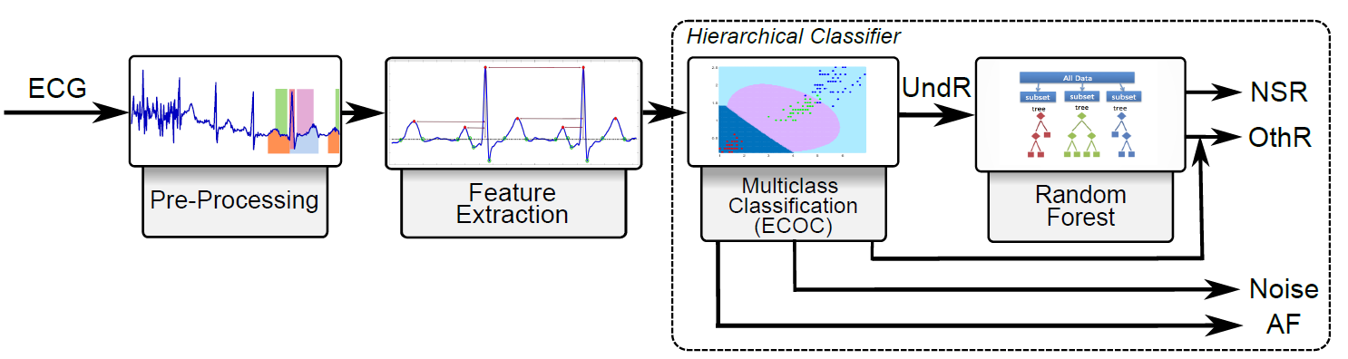
Framework

Slide 20
Preprocessing
Bandpass filter 0.05~40(Hz)
R-peaks are detected using Pan-Tompkins algorithm

Slide 21

Feature extraction
HR-based features: statistical features of
P/T-wave features: statistical features, Shannon entropy, normalized power of concatenate P/T-waves
Time & frequency domain features: QT/QRS-width & normalized signal power at [0.05,50] and [50,fs/2] in order to detect noise ?
Additional features: zero-crossing of P/T-waves

Slide 22
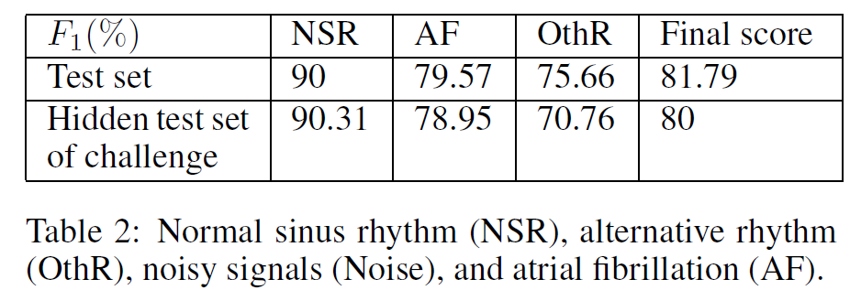
Training & Results
Normalize all features
Multiclass Classifiation(ECOC) Boosting(100 weak learners)
Random forest classifier(binary classify O/N) Boosting(400 weak learners)
?

Slide 23
Discussion
P2 - Centerwave features
P8 - Log-spectrogram
P8 - Augmentation(Dropout-burst, Random resampling)
How to find out noisy signal?
How to choose expert features?

Slide 24
Reference
[1] A Database for Evaluation of Algorithms for Measurement of QT and Other Waveform Intervals in the ECG, P Laguna, RG Mark, A Goldberg, GB Moody,
[2] The impact of the MIT-BIH Arrthythmia Database, George B. Moody, Roger G. Mark

